Slide 1
Cell Cycle Lab Practicum

Slide 2
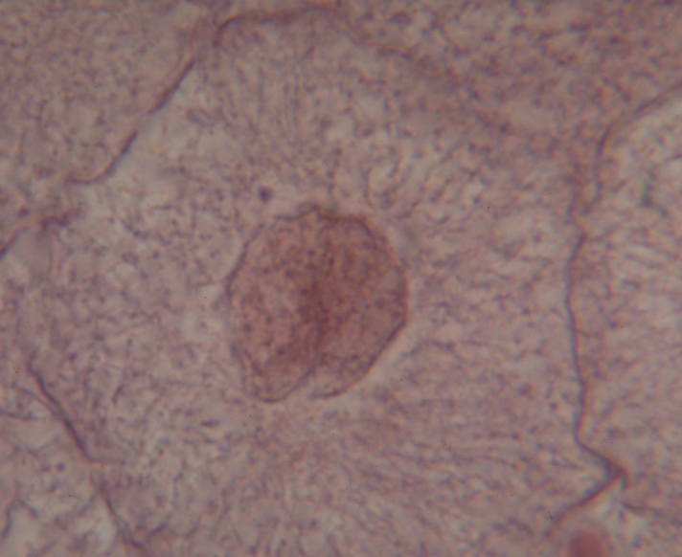
Interphase

Slide 3
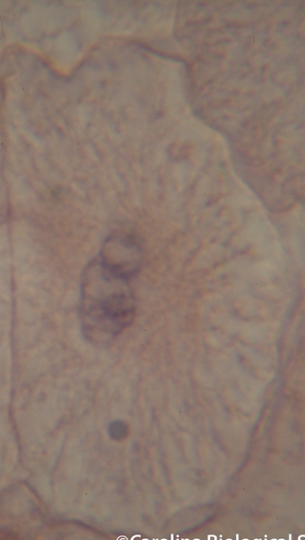
Mitosis-Prophase

Slide 4
Interphase vs Prophase

Slide 5
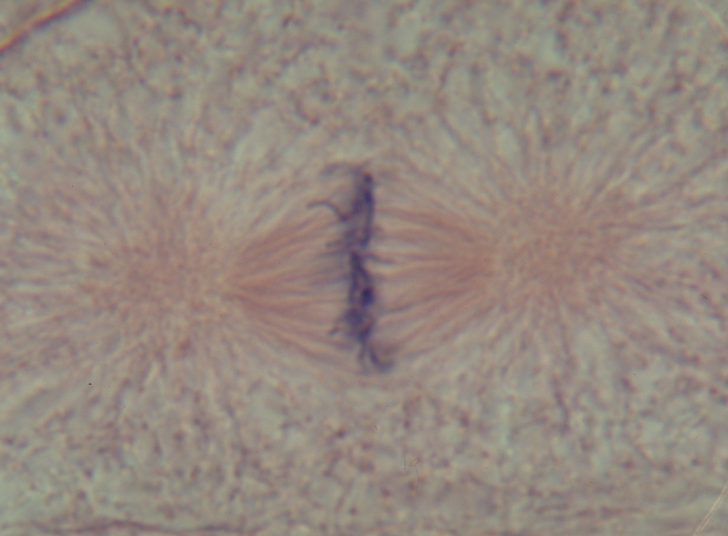
Mitosis-Metaphase

Slide 6
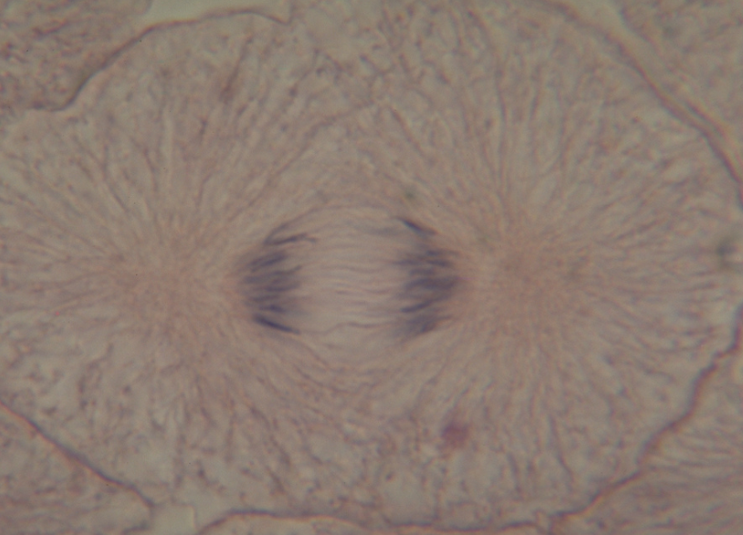
Mitosis-Anaphase

Slide 7
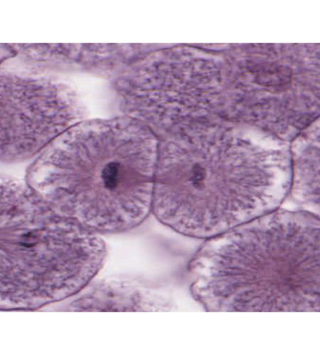
Mitosis- Telophase

Slide 8
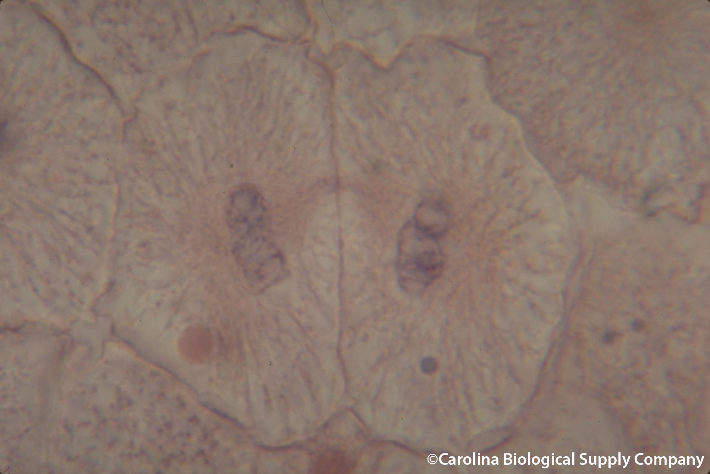
Cytokinesis
Daughter cell
Daughter cell

